Slide 1
Azure Data Studio
Belgium, Mechelen #SQLSatBe
The 30 day Challenge
Martin Croft, SQL Server Solutions

Slide 2




Thank you to our Global Sponsors

Slide 3












Thank you to our local Partners

Slide 4

Who
Martin Croft (Me)
Email martin.croft@sqlserversolutions.co.uk
Twitter @MartinCroft
SQL Server Contractor/Consultant who’s been working with SQL Server since 6.5.
Co-organiser of Manchester PASS Data Platform User Group and SQL Saturday Manchester,
International playboy/speaker

Slide 5

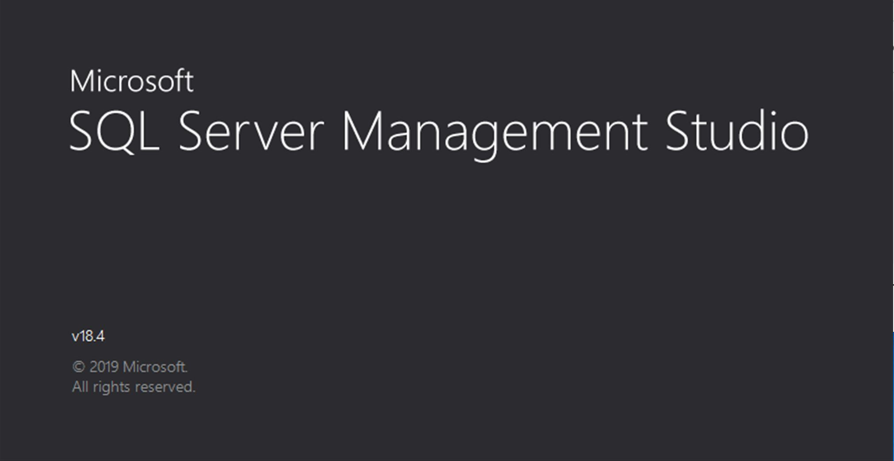
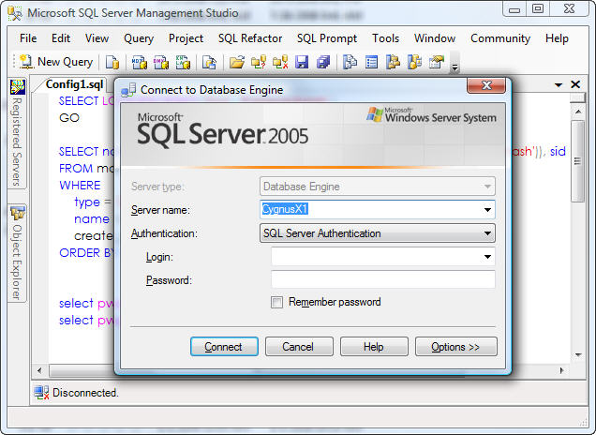
What
In the Beginning there was …
And a while later.. Well a long time later
Then a new application arrived
IT IS NOT A REPLACEMENT FOR SSMS (*Disclaimer)
Cross platform – works for those arty types(MACS) and the one that like to type(Linux)
Built from the ground up (with Visual Studio code base)

Slide 6
Why
I fancied a challenge (and seemed less stupid idea than 99 thing and the batch isn’t one presentation I did )
ADS evolves every month, sometimes more than once!
It has some really cool features (and what a way to get to know them better)
It can do things not possible in SSMS
Hopefully continue to make me more productive!

Slide 7
So what do I do.. And how I’d use it
I’m a DBA, a Data Engineer, a SQL Developer. It varies
But currently I’m a contractor for a Law firm on specific projects ( and part time consultant)
Database migrations/decommissioning & supporting team of developers and analysts
So, deployments, granting access, migration of SQL from versions (SQL 7, 2000, 2008), explaining stuff to developers. database restore, AG group configuration, data extracts, reporting of SQL metrics, SQL Agent jobs setup, still explaining stuff to developers

Slide 8
Demos

Slide 9

Would I go back to SSMS?
Your asking a DBA, Data engineer, Data reliability engineer, so..
It depends…
So both maybe?
SQL Notebooks
Job Management
Short-cut keys
PowerShell
Service broker, SSDB
Registered servers
Extensions
Exporting to Excel
Security changes
Anything to do with AGs
Data visualisation
Profiling and tuning SQL
Source Control

Slide 11


Thank You to our Global SQLSaturday Sponsors

Slide 12
Color palette
Core SQLSaturday Palette
Use these colors for the majority of your presentation.
Accent Colors
These colors may be used sparingly as accents

